Slide 1

Energy Management On Hybrid Electric Vehicle (HEV)
Name: Abhishek Kakkar
Student ID: S3827314

Slide 2
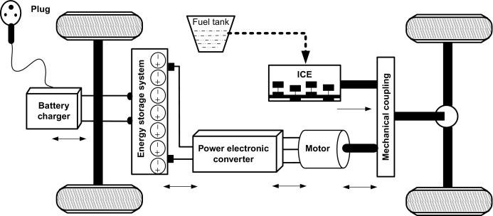
Introduction
HEV (Hybrid Electric Vehicle) is the future of automobile industry but it is still behind to achieve the goal needed.
Improve fuel economy and reduce emission of harmful gases from HEV.
Reduce energy consumption of HEV and increase life of battery.
https://www.sciencedirect.com/topics/engineering/plug-in-hybrid-electric-vehicle

Slide 3
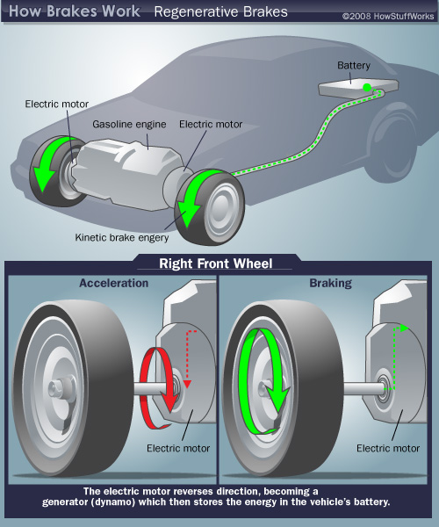
Literature Review
The research on energy management system can be divided into two categories, the first is rule-based energy management strategy and second optimized energy management strategy (which is in theory) [1].
Rule based energy management work on Regenerative braking System [2].
Electric Variable Transmission(EVT). EVT possesses multiple mechanical ports and electrical ports and the energy conversion mode is more flexible than power coupling mechanism in the traditional Vehicle[2].
Control strategy on rear wheel. This proposed regenerative braking control strategy can achieve recovery energy up to 28.29% [3].

Slide 4
Research Gaps
When the braking process completes, the engine should increase the speed to drive the vehicle.
When the vehicle is in hybrid mode brake should disengage to save energy.
Regenerative braking control strategy implementation on front wheel.

Slide 5
Outcomes
Reduce energy consumption
Excessive energy stored in battery which can be utilised afterwards.
If energy control implemented on front wheels means reduce fuel consumption and reduce emission

Slide 6
References
[1] N. Zhang, X. Ma and L. Jin, "Energy management for parallel HEV based on PMP algorithm," 2017 2nd International Conference on Robotics and Automation Engineering (ICRAE), Shanghai, 2017, pp. 177-182
[2] Q. Xu, F. Wang, X. Zhang and S. Cui, "Research on the Efficiency Optimization Control of the Regenerative Braking System of Hybrid Electrical Vehicle Based on Electrical Variable Transmission," in IEEE Access, vol. 7, pp. 116823-116834, 2019
[3] M. Lv, Z. Chen, Y. Yang and J. Bi, "Regenerative braking control strategy for a hybrid electric vehicle with rear axle electric drive," 2017 Chinese Automation Congress (CAC), Jinan, 2017

Slide 7
Thank You

